Slide 1
Development Standards
420-E31 Systems III
References:
Braude – Software Engineering Modern Approaches 2nd Ed
http://msdn.microsoft.com/en-us/library/aa260844(v=vs.60).aspx

Slide 2
Types of Standards
We are going to look at defining standards for:
Coding standards
Interface design (look and feel) standards
Notes:
Ask: Who has been in an organization where coding standards were used?

Slide 3
Coding Standards
A comprehensive coding standard encompasses all aspects of code construction.
Standards should be closely followed.
Usually verified in a code inspection
Completed source code should reflect a harmonized style, as if a single developer wrote the code in one session.
Notes:
Show Sample coding standards:
Java: https://google.github.io/styleguide/javaguide.html
JavaScript: https://google.github.io/styleguide/javascriptguide.xml
SQL: http://www.nyx.net/~bwunder/dbChangeControl/standard.htm
These standards are non-trivial to write up and enforce. Why do you think they exists? What possible benefit could it yield?

Slide 4
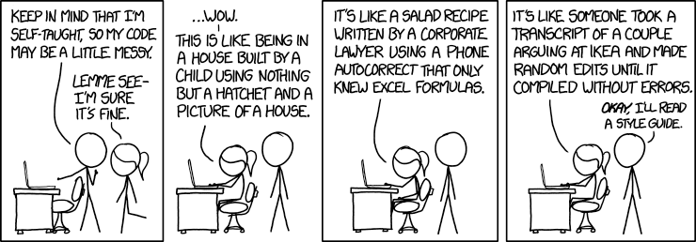
Motivation

Slide 5
Motivation
Given SLDC:
40-80% of the lifetime of a piece of software goes into maintenance
Hardly any software is maintained for its whole life by the original author
Code conventions improve the readability of the software, allowing engineers to understand new code more quickly and thoroughly.
If you ship your source code as a product, you need to make sure it is as well packaged and clean as any other product you create
Notes:
How much of the code’s lifetime is the design, development and initial deployment? ( typically < 20 %).

Slide 6
Motivation:Interesting quotes from professionals
I do not intend to impose my style preferences on other people's code or projects; if an existing common style exists, it should be respected.
"Arguments over style are pointless. There should be a style guide, and you should follow it"
"Part of being a good steward to a successful project is realizing that writing code for yourself is a Bad Idea™. If thousands of people are using your code, then write your code for maximum clarity, not your personal preference of how to get clever within the spec.“
Notes:
Imagine, you saying “I can use this clever construct not known to many people to show how smart I am to do this specific task in as few lines as possible. Would this be maintainable code?

Slide 7

Coding Standards: Golden rule
All code in any code-base should look like a single person typed it, no matter how many people contributed.

Slide 8
Coding Standards – New Project
At the inception of a software project, establish a coding standard to ensure that all developers on the project are working in concert.

Slide 9
Coding Standards–Existing System
When the software project will incorporate existing source code, or when performing maintenance upon an existing software system, the coding standard should state how to deal with the existing code base.

Slide 10
Purpose of Coding Standards
Coding standards usually have no impact on the functionality of the application.
They contribute to an improved comprehension of source code.
Capture best practices within the organization
Generally, it doesn’t matter what standard you choose to use, it’s just having the standard that matters.
Notes:
Best practices: just because a language might allow you to do odd things doesn’t mean you should.

Slide 11
Categories of Standards
Coding standards can be divided into 3 sections:
Names
Comments
Format
Each programming language needs its own standard

Slide 12
Coding Standards: Names
A variable name should tell “what” rather than “how”.
Avoid names that expose the underlying implementation, which can change.
For example, use GetNextStudent() instead of GetNextArrayElement().

Slide 13
Coding Standards: Names
Make names long enough to be meaningful but short enough to avoid being wordy.
Expressive names act as an aid to the human reader so it makes sense to provide a name that the human reader can comprehend.

Slide 14
Which would you rather work with?
// Javascript sample
function q(s) {
return document.querySelectorAll(s);
}
var i,a=[],els=q("#foo");
for(i=0;i<els.length;i++){a.push(els[i]);}

Slide 15
Which would you rather work with?
// Javascript sample
function query( selector ) {
return document.querySelectorAll( selector );
}
var idx = 0,
elements = [],
matches = query("#foo"),
length = matches.length;
for ( ; idx < length; idx++ ) {
elements.push( matches[ idx ] );
}
Notes:
Both code samples have equivalent functionality

Slide 16
Coding Standards: Names
Need naming standards for:
Classes
Methods
Variables
Tables
File/Folder names, Packages

Slide 17
Coding Standards: Names
// From the Google Closure Library Style Guide
//(Javascript)
functionNamesLikeThis;
variableNamesLikeThis;
ConstructorNamesLikeThis;
EnumNamesLikeThis;
methodNamesLikeThis;
SYMBOLIC_CONSTANTS_LIKE_THIS;

Slide 18
Coding Standards: Comments
One of the challenges of software documentation is ensuring that the comments are maintained and updated in parallel with the source code.
Although properly commenting source code serves no purpose at run time, it is invaluable to a developer who must maintain a particularly intricate or cumbersome piece of software.

Slide 19
Coding Standards: Comments
Need comment standards for:
Start of file comments
Class and Method comments
In line comments
Will comments be accepted on the same line as code?

Slide 20
Coding Standards: Format
Formatting makes the logical organization of the code stand out.
Taking the time to ensure that the source code is formatted in a consistent, logical manner is helpful to yourself and to other developers who must decipher the source code.

Slide 21
Coding Standards: Format
Need formatting standards for:
Indentation rules
Mixed case usage
Open/Close bracket format
Maximum line length
White space

Slide 22
Indentation Example
for (i = 0; i < 100; i++){
…
}
for (i = 0; i < 100; i++){
…
}

Slide 23
Indentation Example
If … Then
If … Then
…
Else
…
End If
Else
…
End If
If … Then
If … Then
…
Else
…
End If
Else
…
End If

Slide 24
Coding Standards: Spelling
Need spelling standards for:
US vs English spelling
“color” vs “colour”
Case
Upper case
Lower case
Camel case
UpperCamelCase
lowerCamelCase

Slide 25
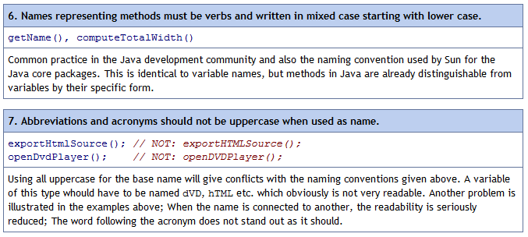
Standards Example
Source: http://geosoft.no/development/javastyle.html#Layout%20of%20the%20Recommendations

Slide 26
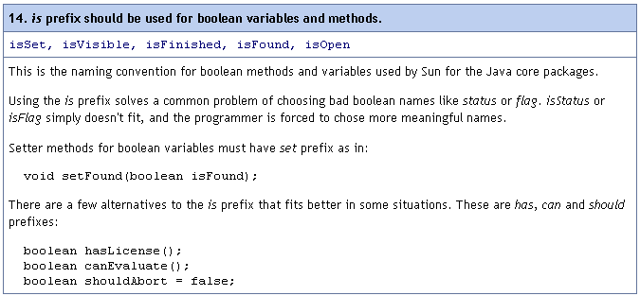
Standards Example
Source: http://geosoft.no/development/javastyle.html#Layout%20of%20the%20Recommendations

Slide 27
Principle of least astonishment
POLA
A typical formulation of the principle is: "If a necessary feature has a high astonishment factor, it may be necessary to redesign the feature."
In general engineering design contexts, the principle can be taken to mean that a component of a system should behave in a manner consistent with how users of that component are likely to expect it to behave; that is, users should not be astonished at the way it behaves.
Notes:
Applies to code too.
Another software designer shouldn’t open up your code and go “WTF?”

Slide 28
Conclusion
By consistently applying a well-defined coding standard and proper coding techniques, and holding routine code reviews, a team of programmers working on a software project is more likely to yield a software system that is easier to comprehend and maintain.

Slide 29
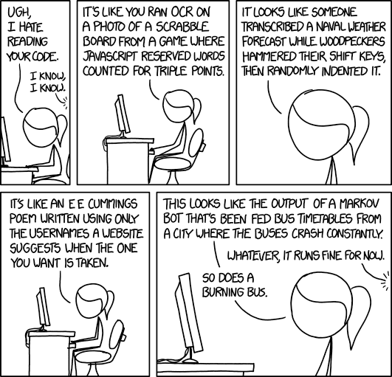
Motivation

